Slide 2
Cool Query Friday
Hunting Your Falcon Dataset Using Frequency Analysis

Slide 3

Andrew-CS
r/CrowdStrike
Question Answerer

Slide 4
First and foremost…

Slide 5
Thank you!
For being here and being part of the CrowdStrike community.

Slide 6
Agenda
CQF Background
Objectives
Threat Hunting Defined
Understanding Aperture
Profiling
Hunting Exercise

Slide 7
CQF Background
Cool Query Friday

Slide 8
Cool Query Friday?

Slide 9
Once upon a time…

Slide 10
Long, long ago…

Slide 11
In a corner of the internet far, far away…

Slide 12
We had an idea 🧠

Slide 13
We wanted a place where customers and CrowdStrike engineers could interact.

Slide 14
This was in 2018.

Slide 15
So we conducted a take-over of r/crowdstrike.

Slide 16
There were 5 users subscribed to r/crowdstrike.

Slide 17
So we started posting content.

Slide 18
And traffic picked up…

Slide 19
…a little.

Slide 20
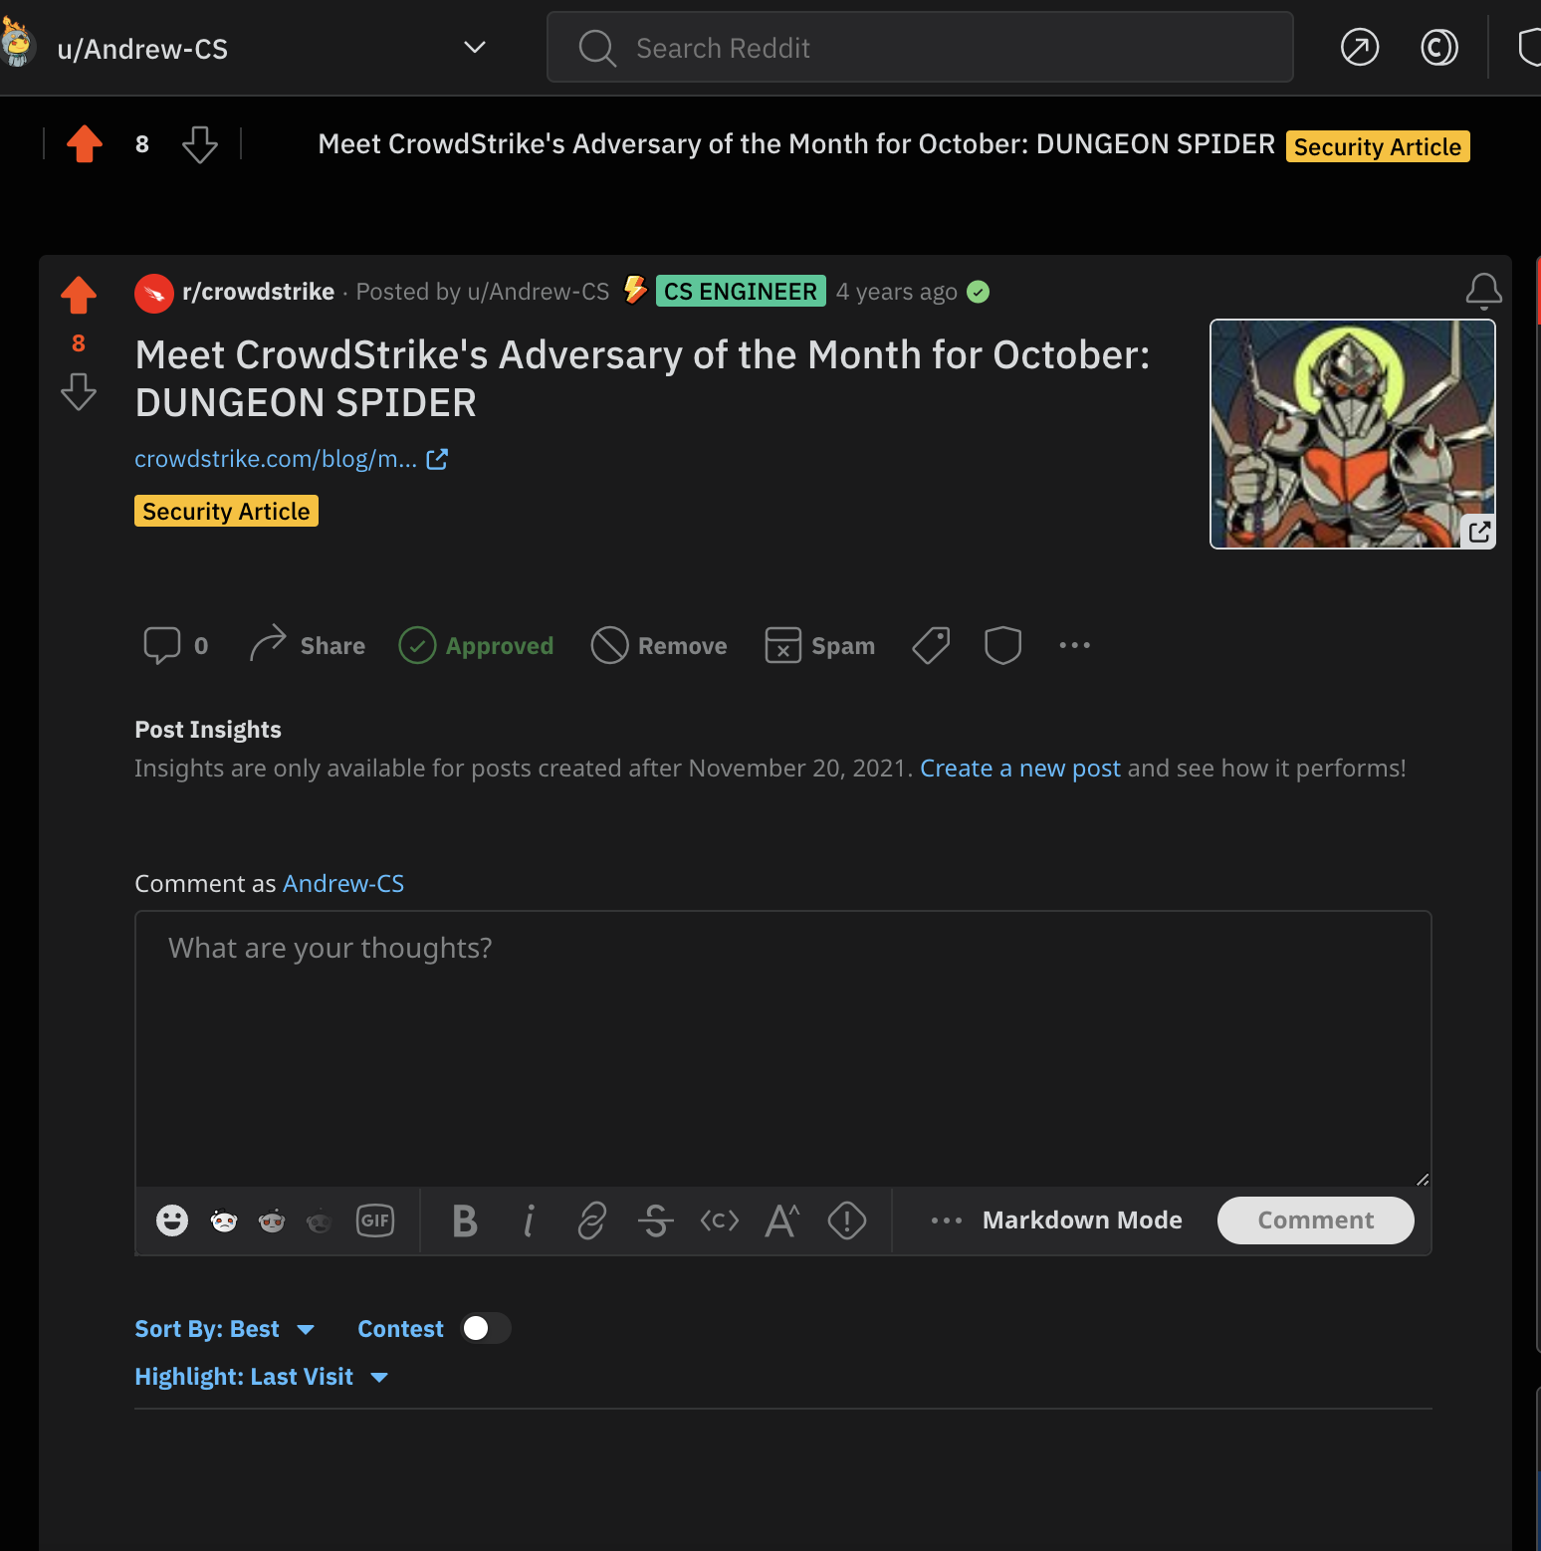

Slide 21
Then in March of 2021, we had another idea 🧠

Slide 22
We’re engineers. We learn by breaking doing things.

Slide 23
So what if we posted tactical tutorials to Reddit to get the hive-mind excited…

Slide 24
…and gave people space to anonymously ask questions.

Slide 25
Then we gave that space a stupid name.

Slide 26
Cool Query Friday

Slide 27
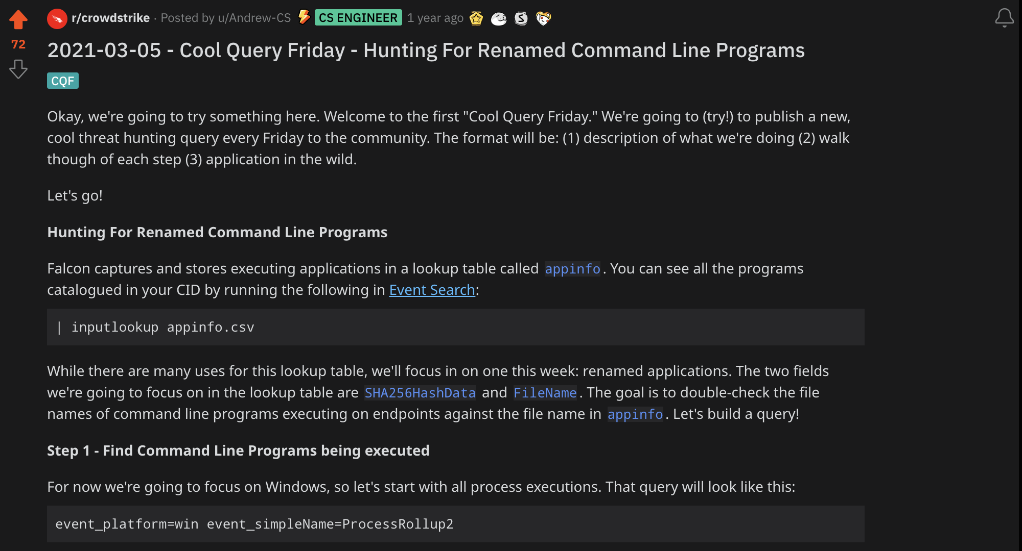

Slide 28
We’ve since started to refer to it as “CQF.”

Slide 29
This is when things really took off.

Slide 30
Fast forward to today…

Slide 31
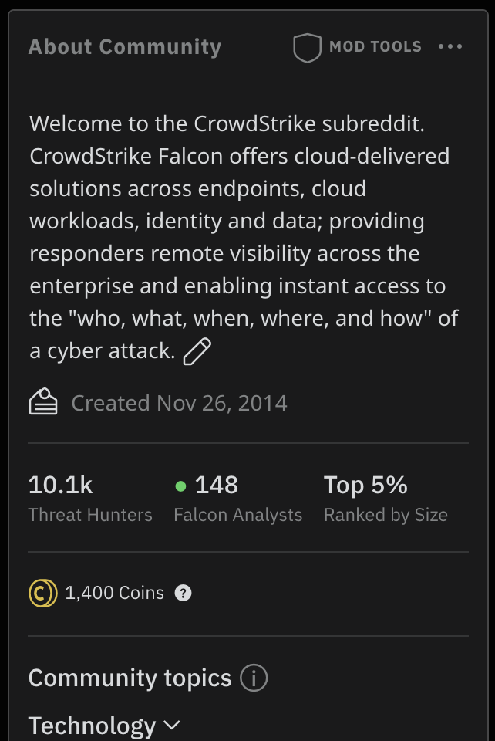
Sub-Reddit Stats
10.1k
Top
950+
Subscribers
Top 5% by Size
Contributors

Slide 32
We even wrote a plugin for LogScale to pull metrics!

Slide 33
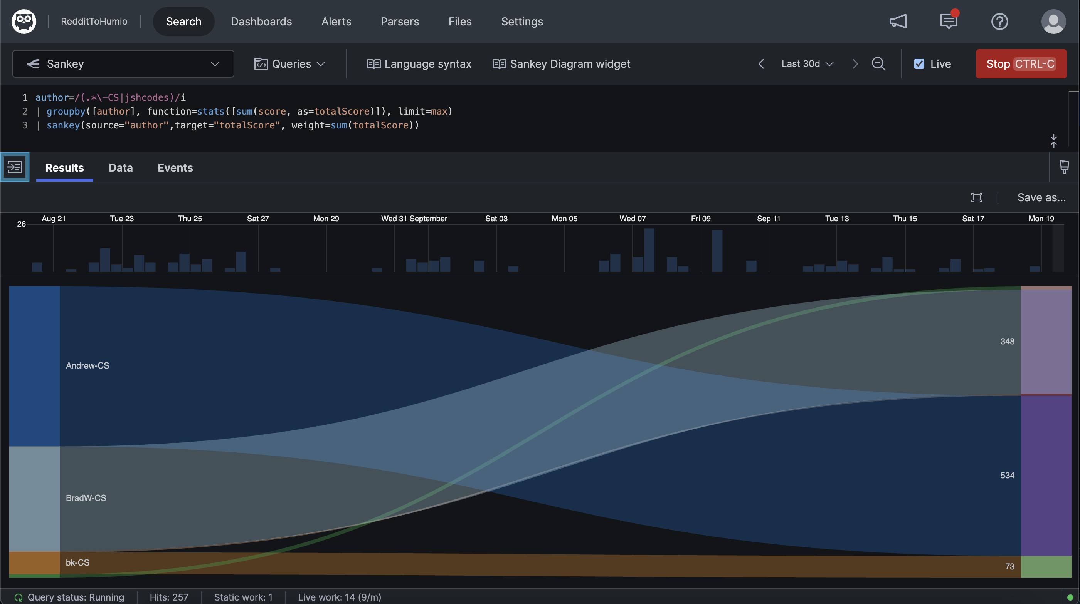
Most Active CrowdStrikers

Slide 34
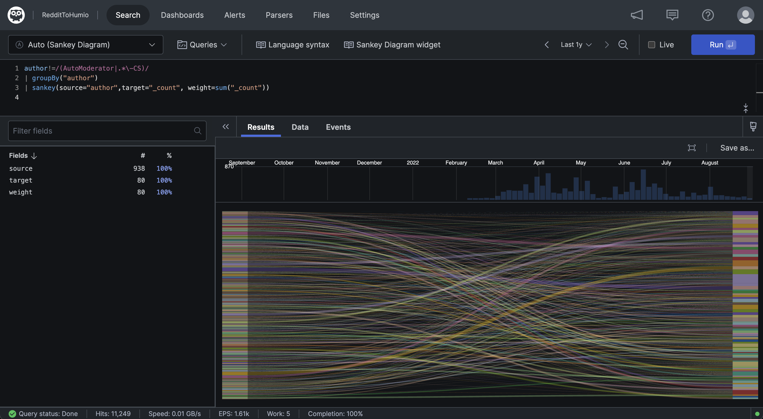
Most Active Non-CrowdStrikers

Slide 35
🤯

Slide 36
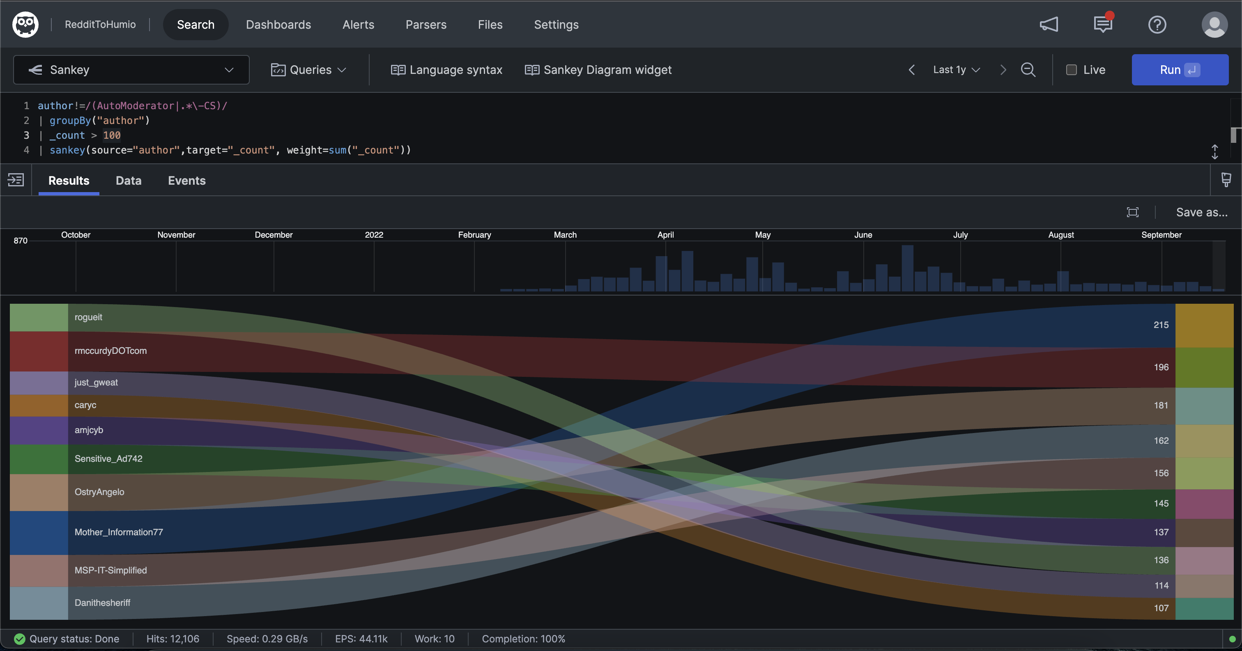
Most Active Non-CrowdStrikers with 100+ Contributions

Slide 37
So if you were thinking…

Slide 38
…what in the world is Cool Query Friday?!

Slide 39
Now you know!

Slide 40
Objectives
Cool Query Friday

Slide 41
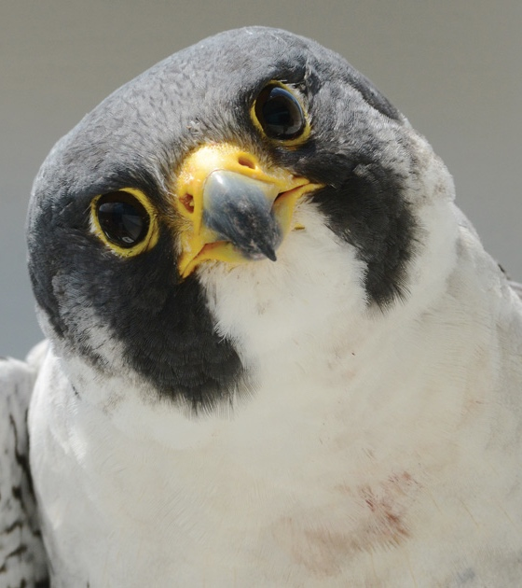
Objectives
Devise a method to logically organize endpoints, processes, and/or users based on operating environment
Create a hypothesis within that framework
Test Hypothesis
Iterate
Document
Repeat

Slide 42
Threat Hunting Defined
Cool Query Friday

Slide 43

Threat hunting is not…
…any of these things.
Alert triage or log review
Detection review and resulting investigations
Applying IOCs to incoming telemetry
Without structure or process
A tool; no need for people/process
Passive

Slide 44

Threat hunting does…
Use statistical methods to find outliers
Use the scientific method for consistency
Use hypothesis testing
Employ threat intelligence to search for historic activity
Focus on behaviors
Lives and breaths… it’s an active process

Slide 45

OverWatch
This session is not specifically about threat hunting theory, however…
CrowdStrike’s OverWatch Team has developed the S.E.A.R.C.H. methodology
Can learn more about it here: https://www.crowdstrike.com/blog/successful-threat-hunting-starts-with-search/
If you need a starting point, remember: good artists copy, but great artists steal.

Slide 46
Understanding Aperture
Cool Query Friday

Slide 47

Global vs Local
When performing analysis on an endpoint dataset, it’s important to consider “aperture”
Often, the wider the aperture the more generic you have to be with your analysis
If you can tighten the aperture, you can be more specific and variances from more tightly defined norms will surface quicker

Slide 48

CrowdStrike’s Aperture
Hundreds of millions of workloads/endpoints
Tens of thousands of customers
175+ countries
2 Trillion+ events per day
Every conceivable endpoint configuration
Etc.

Slide 49
Morale of the story…

Slide 50
We have to use a very wide aperture when creating signal logic

Slide 51

Customer Aperture
Thousands of endpoints
One “customer” or a narrower subset of subsidiaries
Relatively fixed number of endpoint configurations
Endpoint bucketing can be done on granular level
But, the most important thing…

Slide 52
You know stuff about your environment that a vendor could never know.

Slide 53
So you can profile systems, users, and processes more aggressively and with greater precision.

Slide 54
Profiling
Cool Query Friday

Slide 55
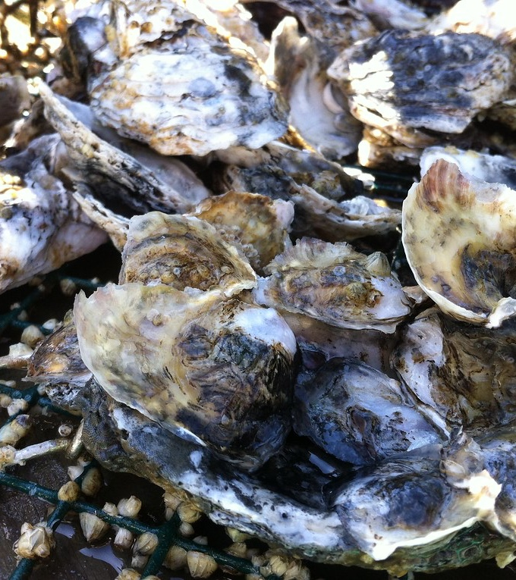
Profiling
The world is your oyster with local aperture
System Type
Operating System
Machine Domain, OU, Site Name
Internal/External IP
GeoIP Location
Hostname patterns
Cloud Provider
Arbitrary Tags
Process Lineage/Relationships
Etcetera

Slide 56
Methodology
Cool Query Friday

Slide 57
Methodology
Hypothesis/Criteria
Create Logic
Document
Validate
Place in Harness
Test
Tune
Hypothesis created or criteria given
Create Evaluation Logic
Document iterations and steps
Test
Tune
Validate
Place in Harness

Slide 58
Methodology
Hypothesis/Criteria
Create Evaluation Logic
Document
Validate
Place in Harness
Test
Tune
CVEs, MITRE ATT&CK, Academic Papers, Twitter, Internal knowledge, Intuition, fiat, etc..
Event Search/LogScale
JIRA, ServiceNow, etc.
Event Search/Custom IOA/LogScale
Event Search /Custom IOA/ LogScale
Event Search/Detect UI
Scheduled Search/Custom IOA

Slide 59
Hunting Exercise
Cool Query Friday

Slide 60
Two examples…

Slide 61

MITRE ATT&CK
Working thought MITRE ATT&CK Enterprise matrix
Looking to create weak signal from ATT&CK descriptions and sub-techniques

Slide 62

Twitter
Someone drops spicy, hot tradecraft on Twitter for the lolz
You want to create weak signal around described tradecraft

Slide 63
[T1087.001]

Slide 64
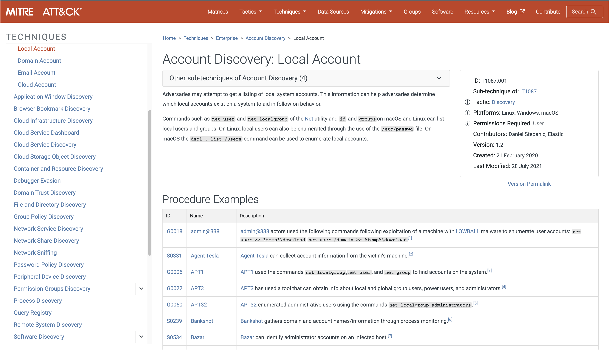
[T1087.001]

Slide 65
1. Hypothesis

Slide 66
The usage of “net” to enumerate users and local groups in my environment should be scoped to specific users, groups of users, or programs.

Slide 67
2. Create Logic

Slide 68
T1087.001 Windows Logic
Description | Event Search | LogScale
Get raw events | event_platform=win event_simpleName=ProcessRollup2 FileName IN (net.exe, net1.exe) | #event_simpleName=ProcessRollup2 event_platform=Win ImageFileName=/\\(net|net1)\.exe/i
Get command line strings of interest | | regex CommandLine=".*\s+(user|localgroup)\s+.*" | | CommandLine=/\s+(user|localgroup)\s+/i
Perform Statistical Analysis | | stats dc(aid) as uniqueEndpointCount, count(aid) as executionCount, dc(CommandLine) as cmdLineVariations by FileName | | ImageFileName=/\\(?<fileName>(net|net1)\.exe)/i | groupby([fileName], function=stats([count(aid, distinct=true, as="uniqueEndpointCount"), count(aid, as="executionCount"), count(CommandLine, as="cmdVariations", distinct=true)]), limit=max)

Slide 69
T1087.001 – General Frequency Analysis
Event Search | LogScale
event_platform=win event_simpleName=ProcessRollup2 FileName IN (net.exe, net1.exe) | regex CommandLine=".*\s+(user|localgroup)\s+.*" | stats dc(aid) as uniqueEndpointCount, count(aid) as executionCount, dc(CommandLine) as cmdLineVariations by FileName | #event_simpleName=ProcessRollup2 event_platform=Win ImageFileName=/\\(net|net1)\.exe/i | CommandLine=/\s+(user|localgroup)\s+/i | ImageFileName=/\\(?<fileName>(net|net1)\.exe)/i | groupby([fileName], function=stats([count(aid, distinct=true, as="uniqueEndpointCount"), count(aid, as="executionCount"), count(CommandLine, as="cmdVariations", distinct=true)]), limit=max)

Slide 70
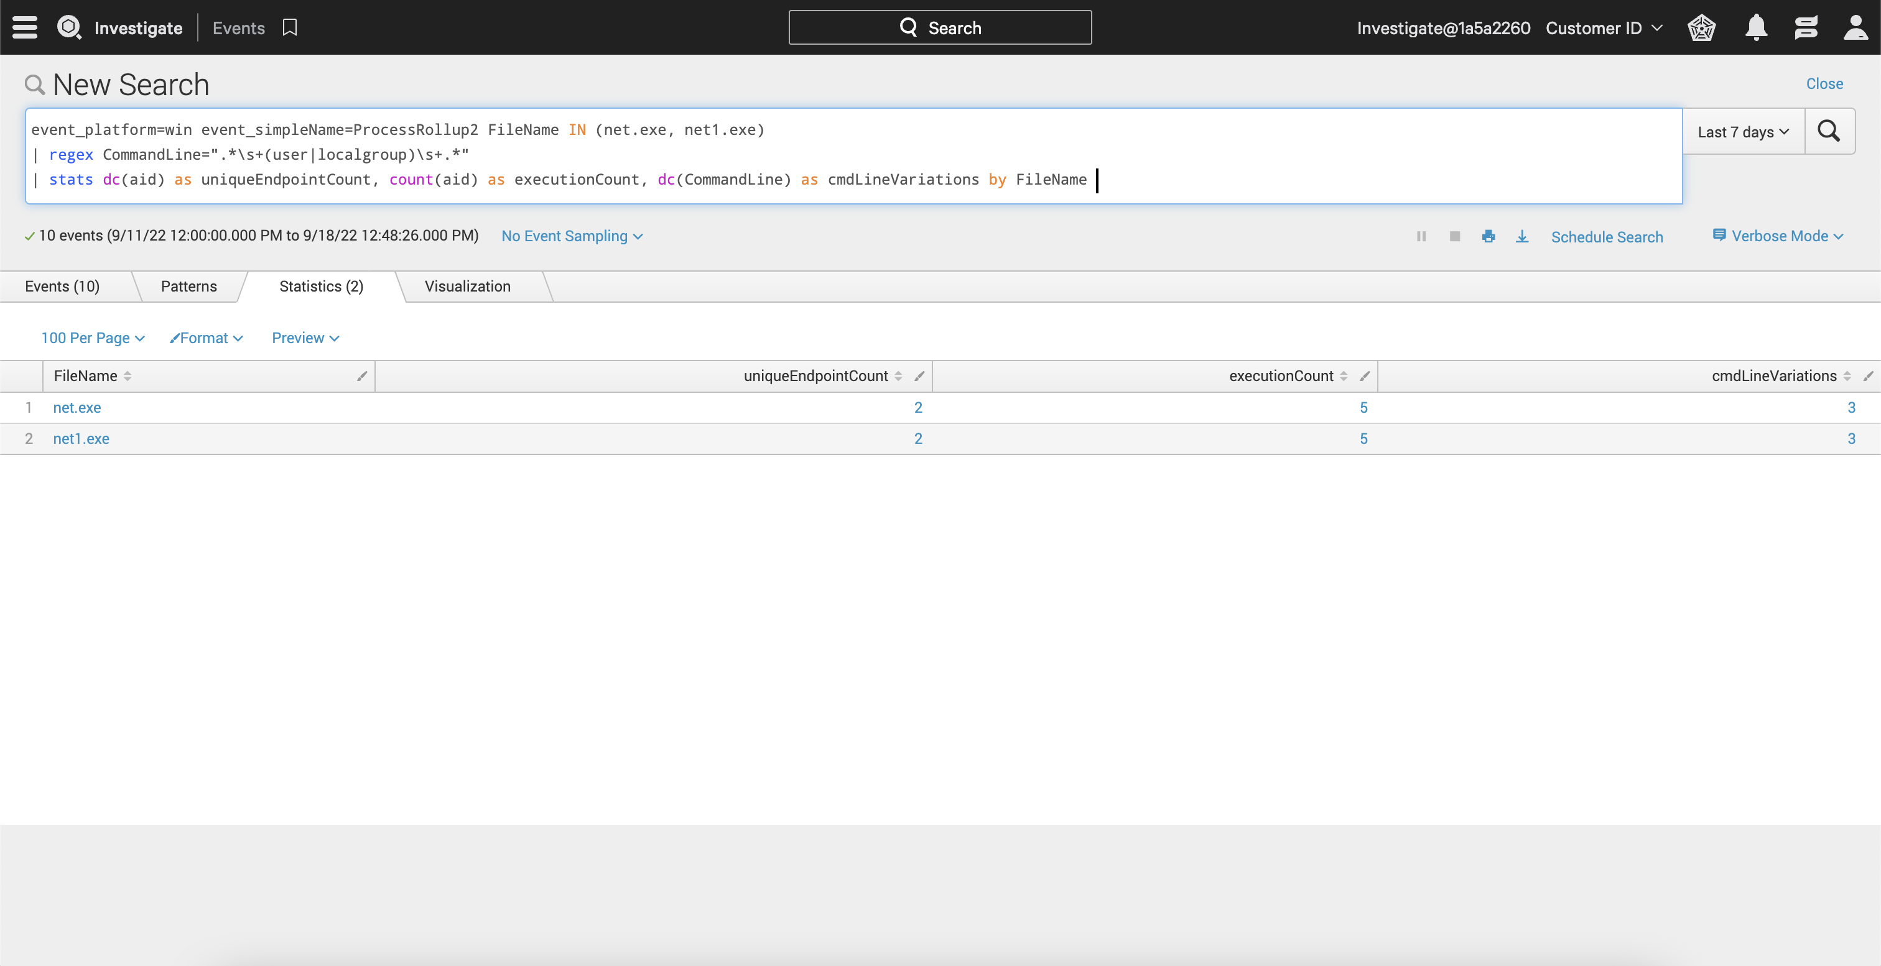

Slide 71
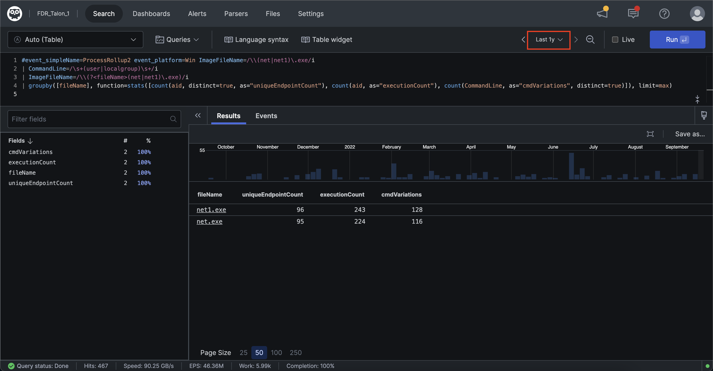

Slide 72
T1087.001 – User Frequency Analysis
Event Search | LogScale
event_platform=win event_simpleName=ProcessRollup2 FileName IN (net.exe, net1.exe) | regex CommandLine=".*\s+(user|localgroup)\s+.*" | rex field=CommandLine ".*net\s+(?<netCommand>\S+)\s+.*" | stats dc(aid) as uniqueEndpointCount, count(aid) as executionCount, dc(CommandLine) as cmdLineVariations by UserSid_readable, UserName | #event_simpleName=ProcessRollup2 event_platform=Win ImageFileName=/\\(net|net1)\.exe/i | CommandLine=/\s+(user|localgroup)\s+/i | ImageFileName=/\\(?<fileName>(net|net1)\.exe)/i | groupby([UserSid], function=stats([count(aid, distinct=true, as="uniqueEndpointCount"), count(aid, as="executionCount"), count(CommandLine, as="cmdVariations", distinct=true)]), limit=max)

Slide 73
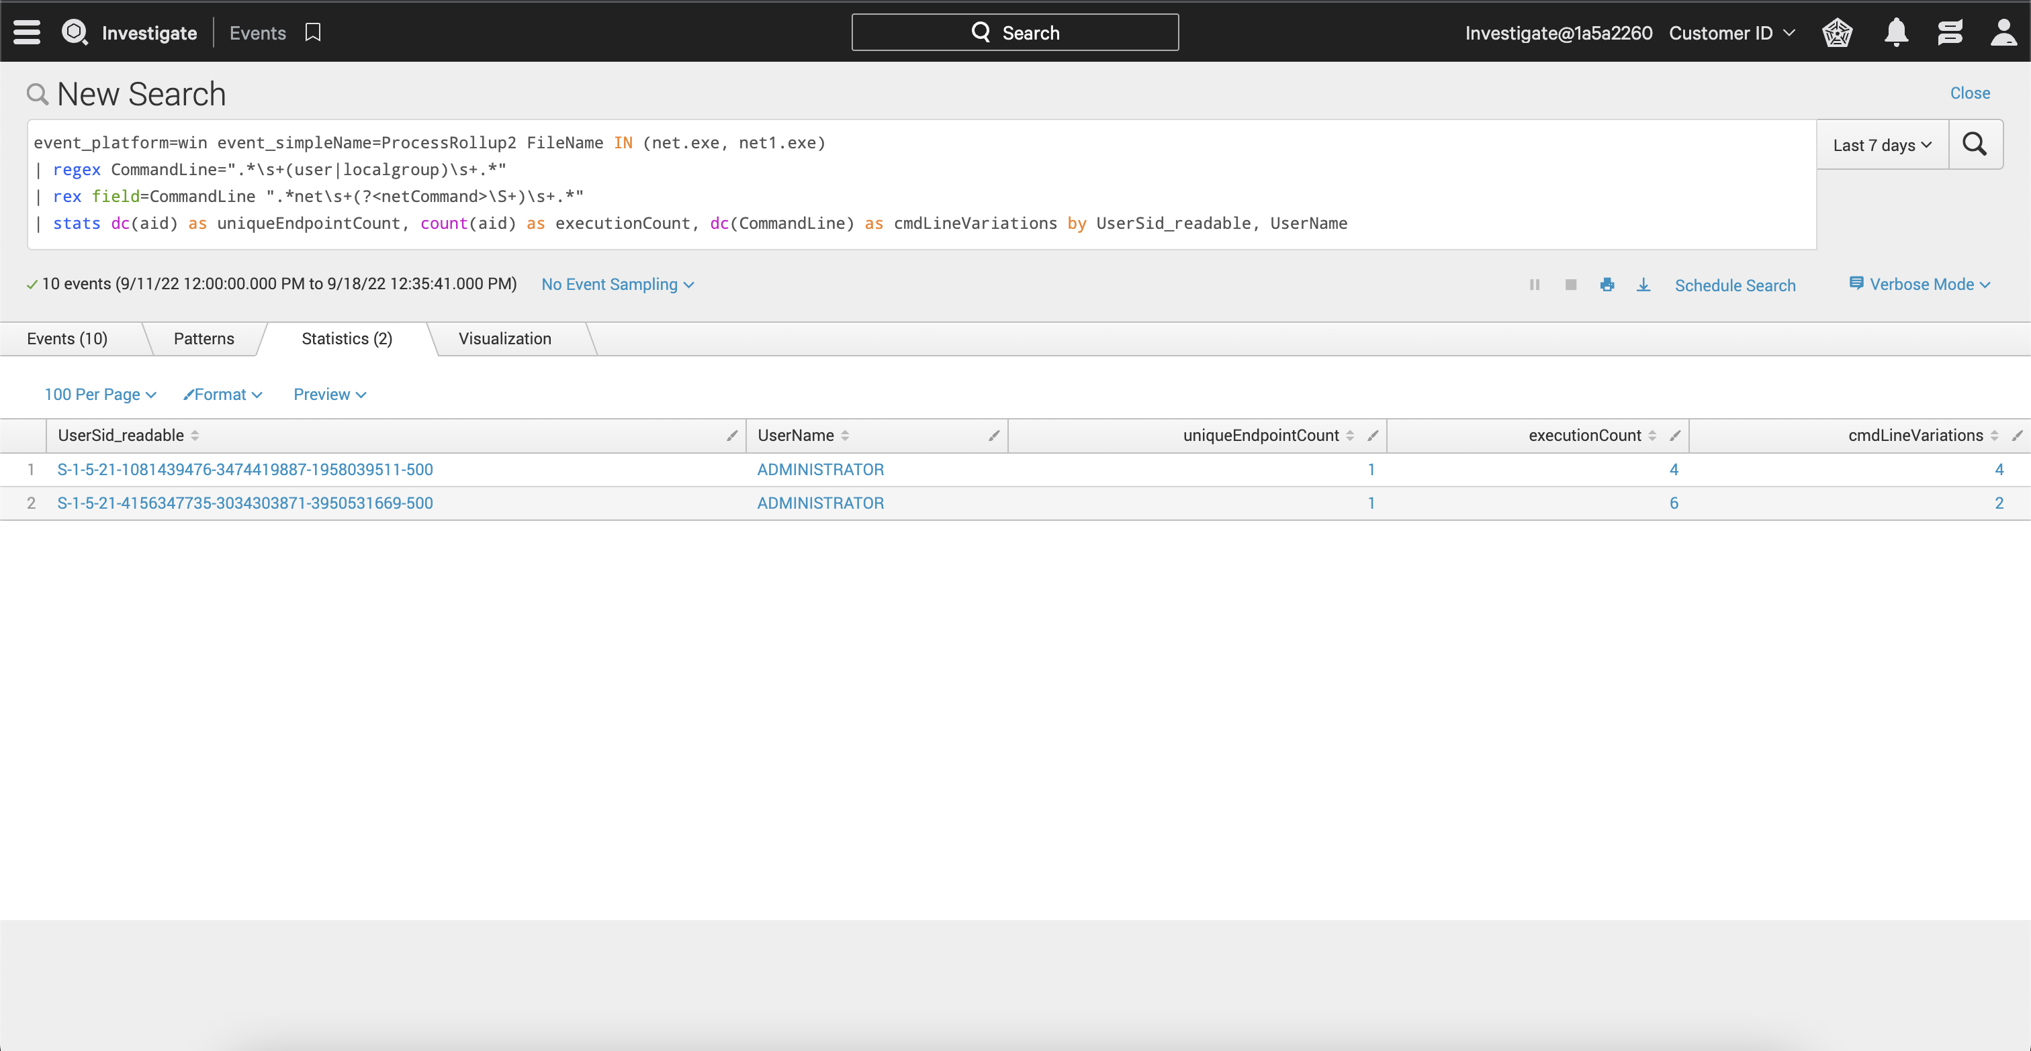

Slide 74
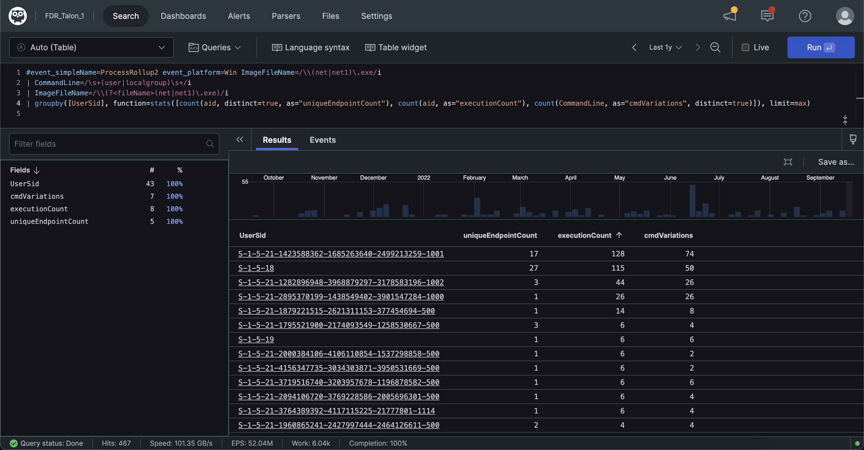

Slide 75
T1087.001 – Process Lineage Analysis
Event Search | LogScale
event_platform=win event_simpleName=ProcessRollup2 FileName IN (net.exe, net1.exe) | regex CommandLine=".*\s+(user|localgroup)\s+.*" | rex field=CommandLine ".*net\s+(?<netCommand>\S+)\s+.*" | fillnull value="Unknown" GrandParentBaseFileName | eval processLineage = GrandParentBaseFileName. " > " .ParentBaseFileName. " > " .FileName | stats dc(aid) as uniqueEndpointCount, count(aid) as executionCount, dc(CommandLine) as cmdLineVariations by processLineage | #event_simpleName=ProcessRollup2 event_platform=Win ImageFileName=/\\(net|net1)\.exe/i | CommandLine=/\s+(user|localgroup)\s+/i | ImageFileName=/\\(?<fileName>(net|net1)\.exe)/i | groupby([UserSid], function=stats([count(aid, distinct=true, as="uniqueEndpointCount"), count(aid, as="executionCount"), count(CommandLine, as="cmdVariations", distinct=true)]), limit=max)

Slide 76
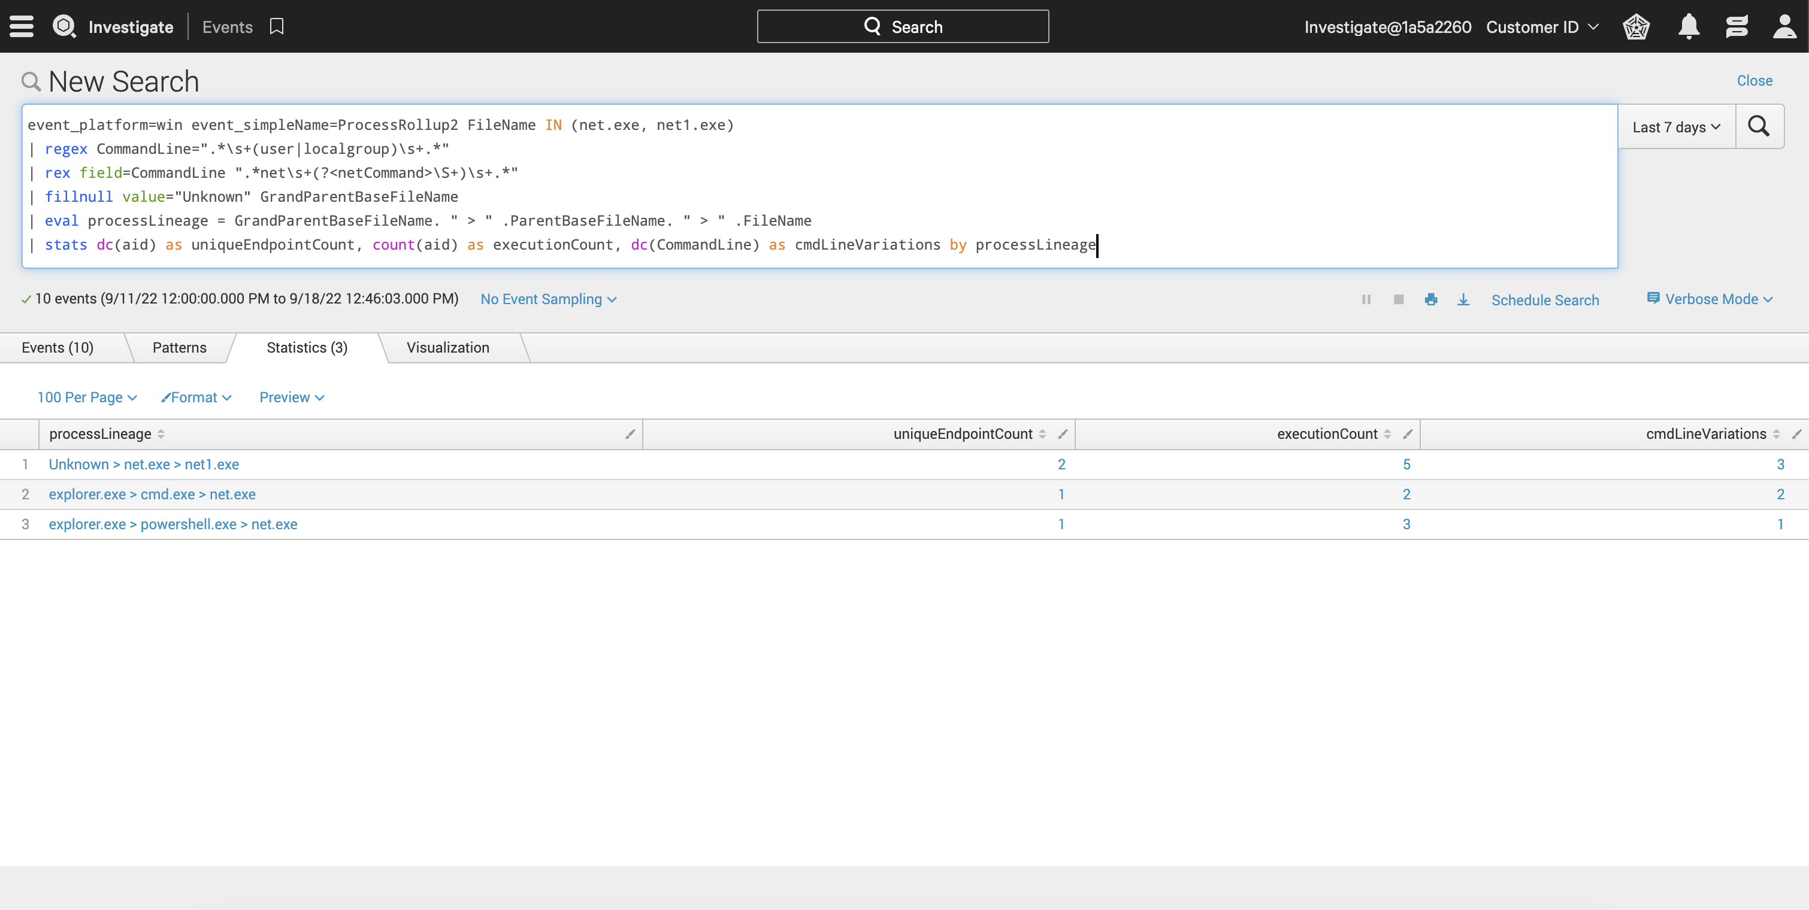

Slide 77
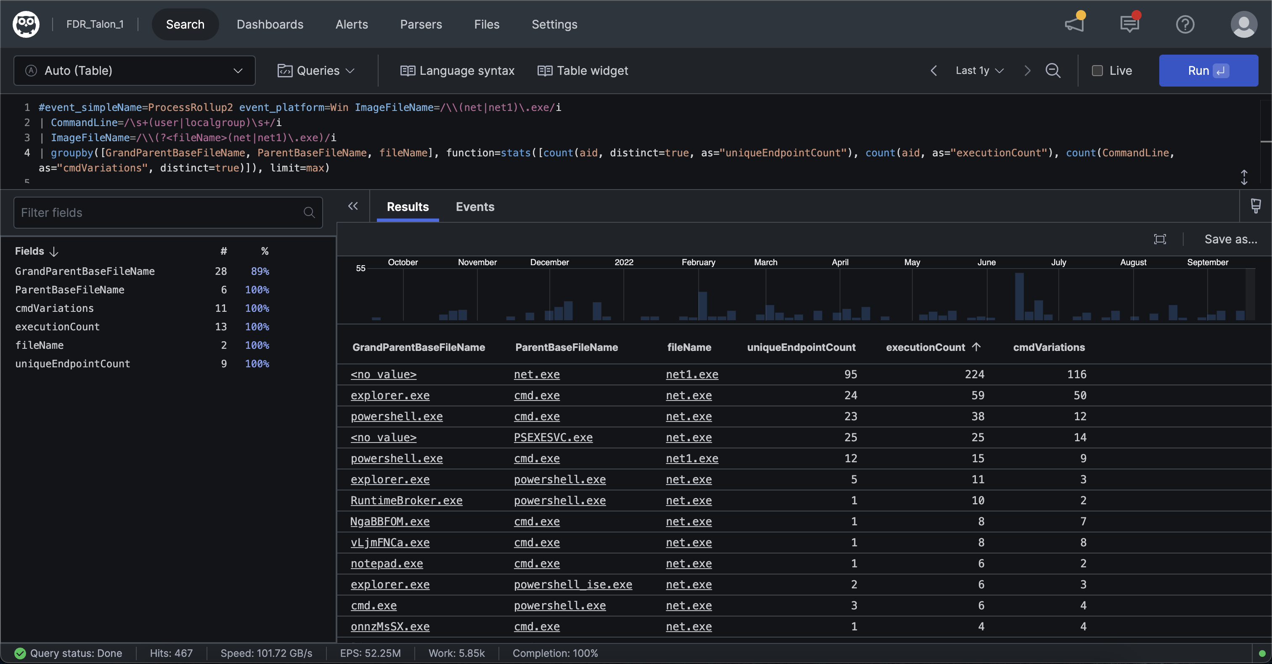

Slide 78
T1087.001 – Net Operator Analysis
Event Search | LogScale
event_platform=win event_simpleName=ProcessRollup2 FileName IN (net.exe, net1.exe) | regex CommandLine=".*\s+(user|localgroup)\s+.*" | rex field=CommandLine ".*net1?\s+(?<netCommand>\S+)\s+.*" | stats dc(aid) as uniqueEndpointCount, count(aid) as executionCount, dc(CommandLine) as cmdLineVariations, values(CommandLine) as cmdLines by netCommand | #event_simpleName=ProcessRollup2 event_platform=Win ImageFileName=/\\(net|net1)\.exe/i | CommandLine=/\s+(user|localgroup)\s+/i | ImageFileName=/\\(?<fileName>(net|net1)\.exe)/i | CommandLine=/net1?\s+(?<netCommand>\S+)\s+/i | groupby([netCommand], function=stats([count(aid, distinct=true, as="uniqueEndpointCount"), count(aid, as="executionCount"), count(CommandLine, as="cmdVariations", distinct=true), collect(CommandLine)]), limit=max)

Slide 79
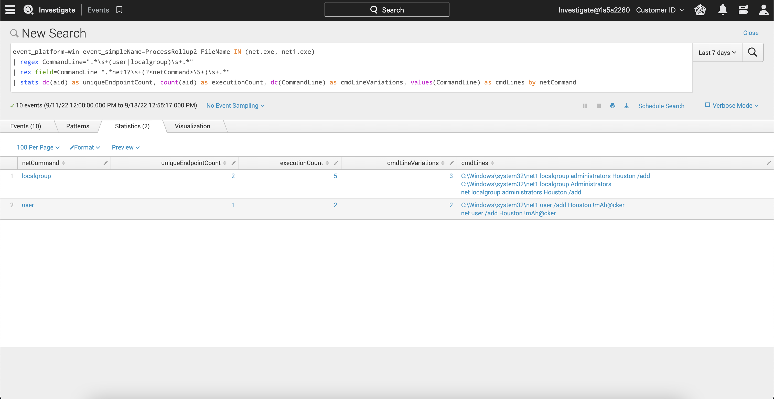

Slide 80
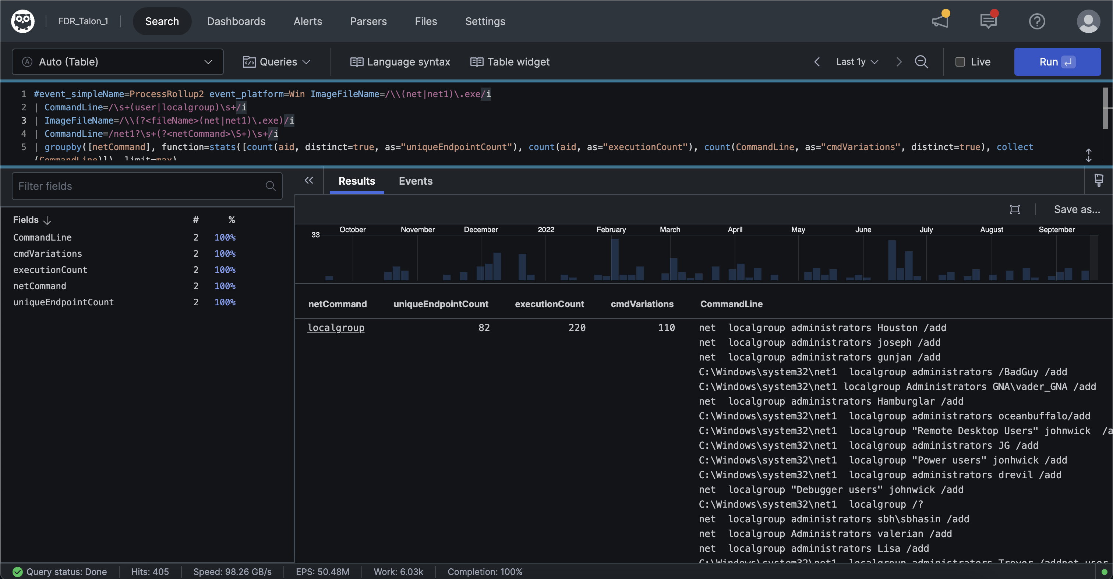

Slide 81
Bonus LogScale Content

Slide 82
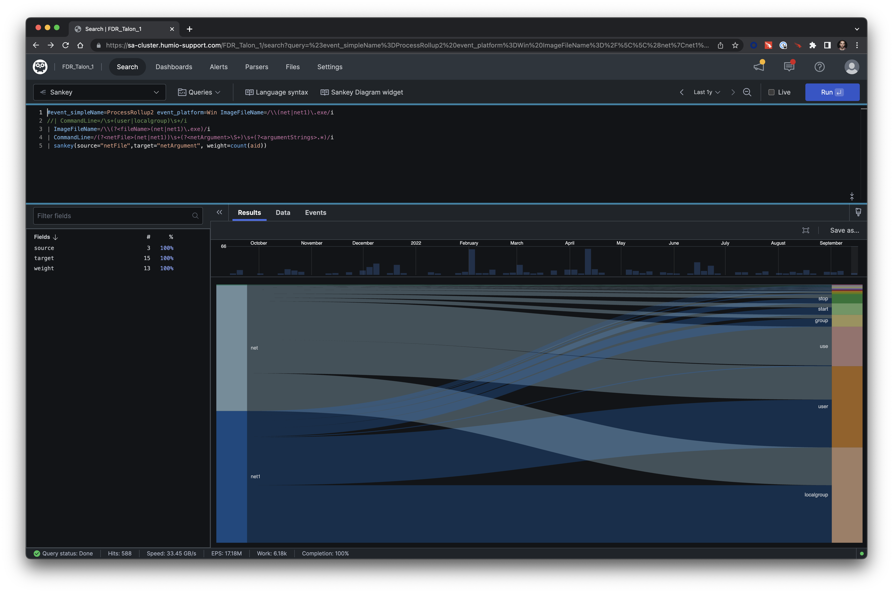
Notes:
Sankey Query:
#event_simpleName=ProcessRollup2 event_platform=Win ImageFileName=/\\(net|net1)\.exe/i
//| CommandLine=/\s+(user|localgroup)\s+/i
| ImageFileName=/\\(?<fileName>(net|net1)\.exe)/i
| CommandLine=/(?<netFile>(net|net1))\s+(?<netArgument>\S+)\s+(?<argumentStrings>.*)/i
| sankey(source="netFile",target="netArgument", weight=count(aid))

Slide 83
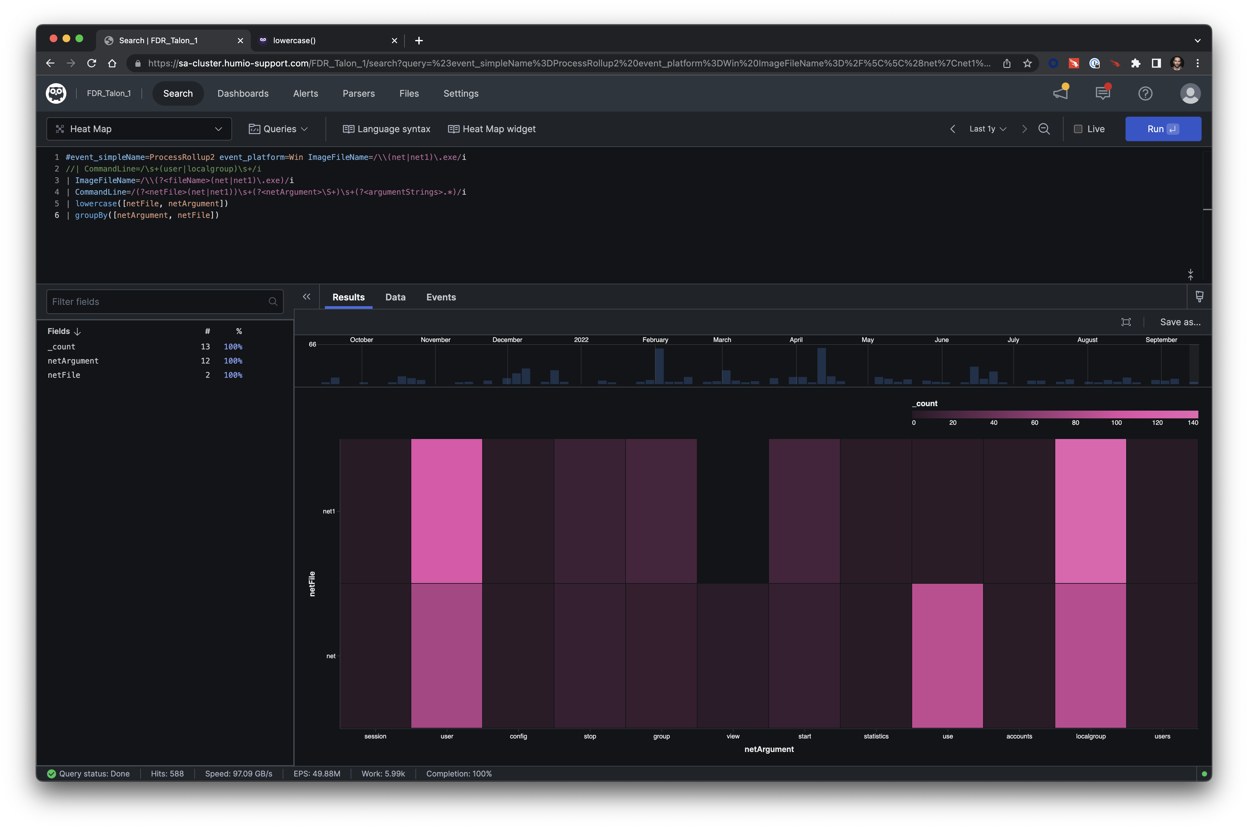
Notes:
Heatmap Query:
#event_simpleName=ProcessRollup2 event_platform=Win ImageFileName=/\\(net|net1)\.exe/i
//| CommandLine=/\s+(user|localgroup)\s+/i
| ImageFileName=/\\(?<fileName>(net|net1)\.exe)/i
| CommandLine=/(?<netFile>(net|net1))\s+(?<netArgument>\S+)\s+(?<argumentStrings>.*)/i
| lowercase([netFile, netArgument])
| groupBy([netArgument, netFile])

Slide 84
3. Document

Slide 85
Do👏not 👏skip 👏this👏step 👏

Slide 86
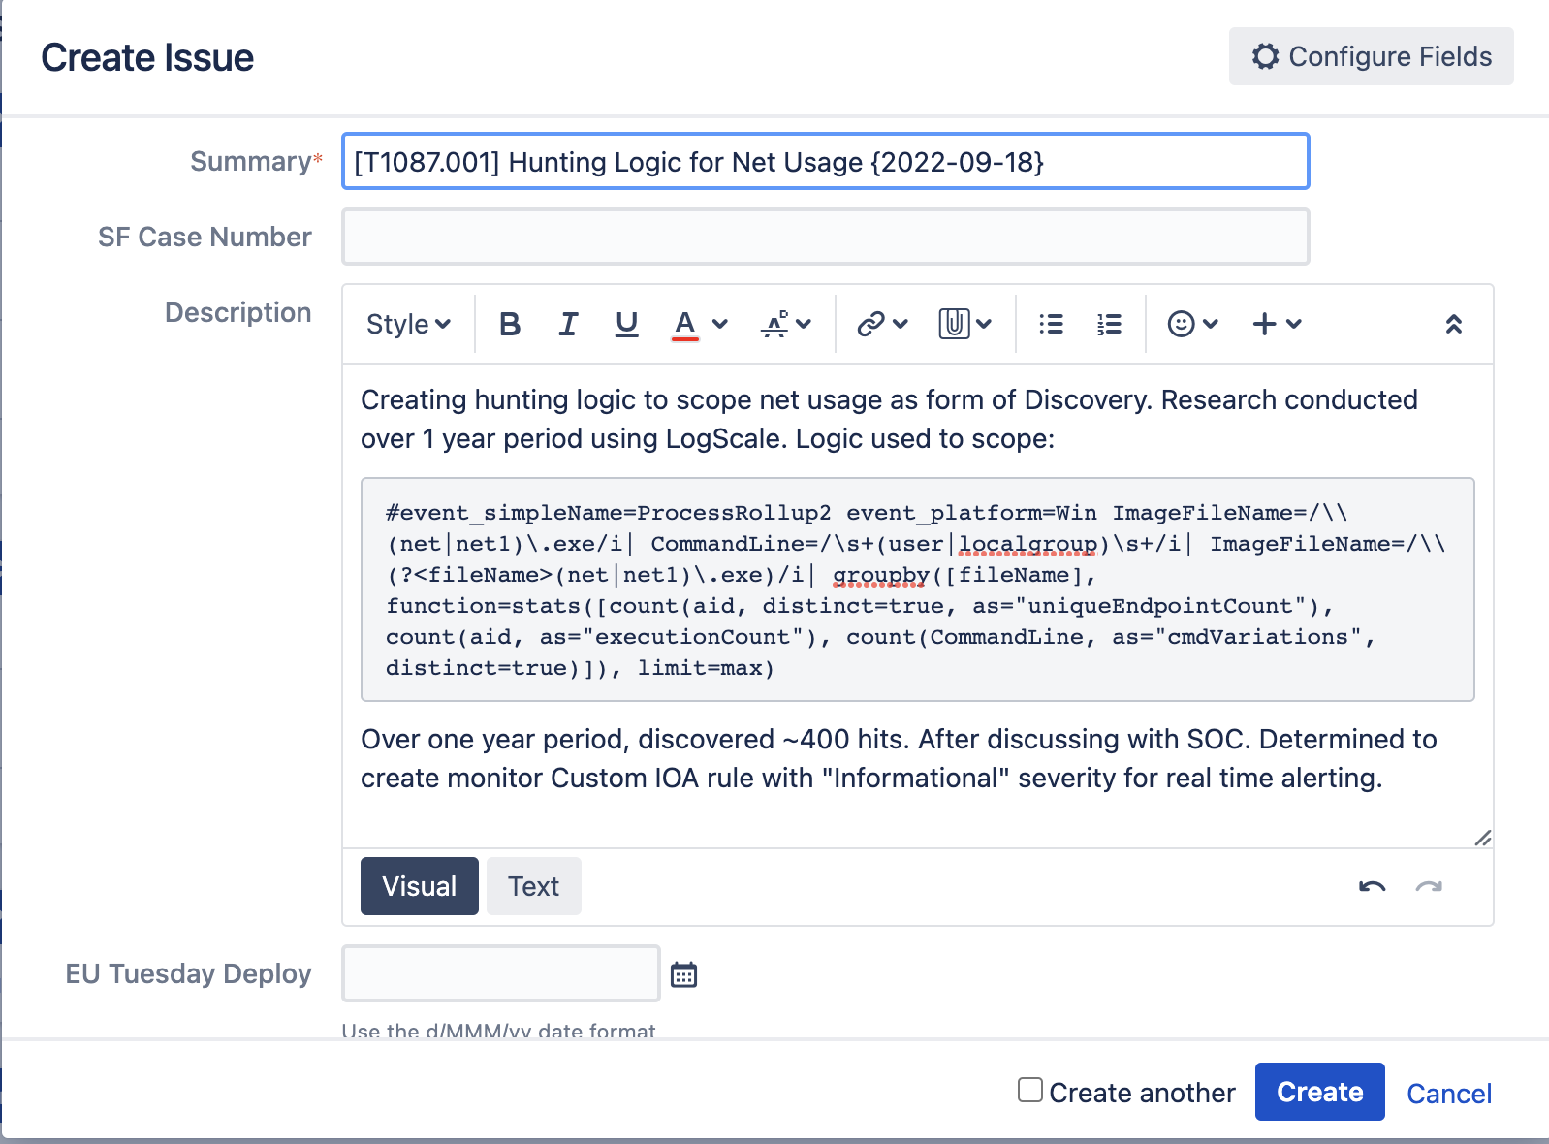

Slide 87
Recap…

Slide 88
Methodology
Hypothesis/Criteria
Create Logic
Document
Validate
Place in Harness
Test
Tune
Hypothesis created or criteria given
Create Evaluation Logic
Document iterations and steps
Test
Tune
Validate
Place in Harness

Slide 89
7. Place in Harness
After research, we’ve concluded that we want to see these alerts in real time as they can be a sign of early reconnaissance by an adversary
Expected volume in detection harness ~400 alerts per year or ~7 alerts per week
Will continue to look for known-good behavior to tune logic to bring volume down
Creating Custom IOA Loigc
Documenting in JIRA what logic of Custom IOA is

Slide 90

Creating Custom IOAs
Create IOA Rule Group with MITRE ATT&CK Tactic name and number
Place rule associated with Tactic in rule group
Name rule sub-Technique
Makes searching easier

Slide 91
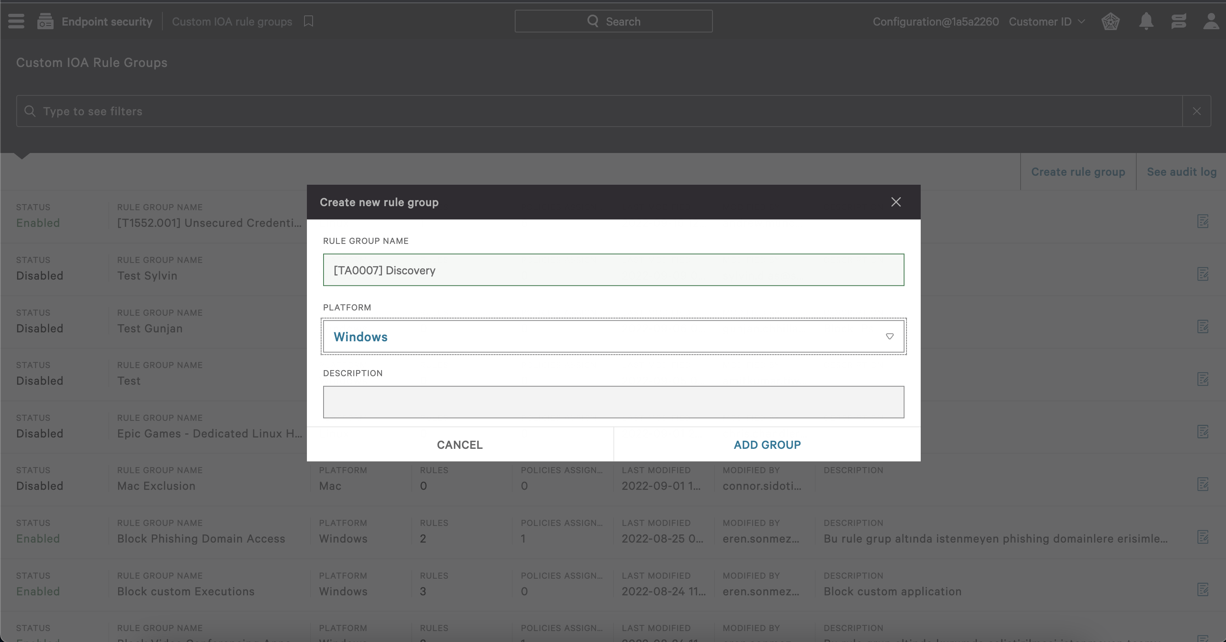

Slide 92
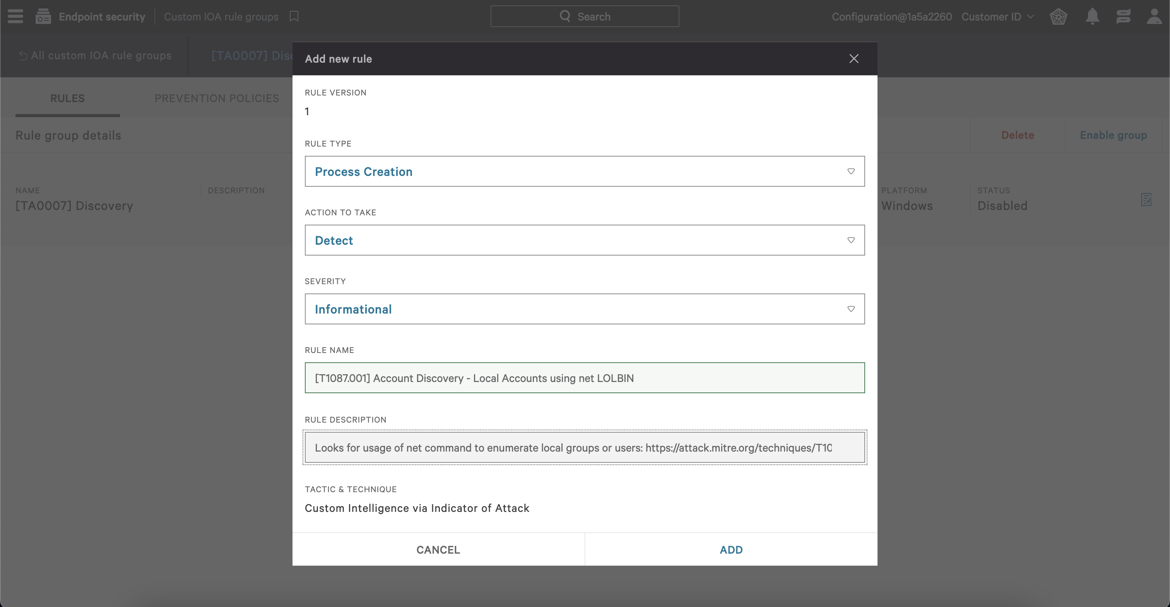

Slide 93
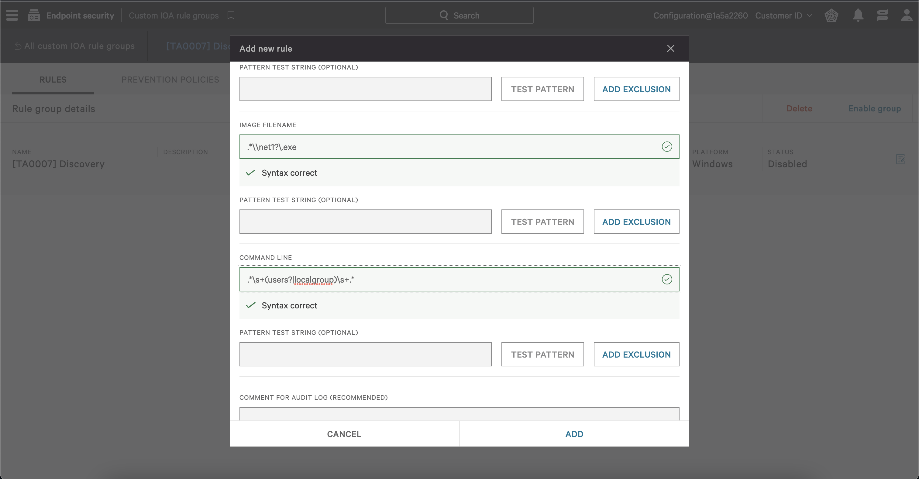

Slide 94
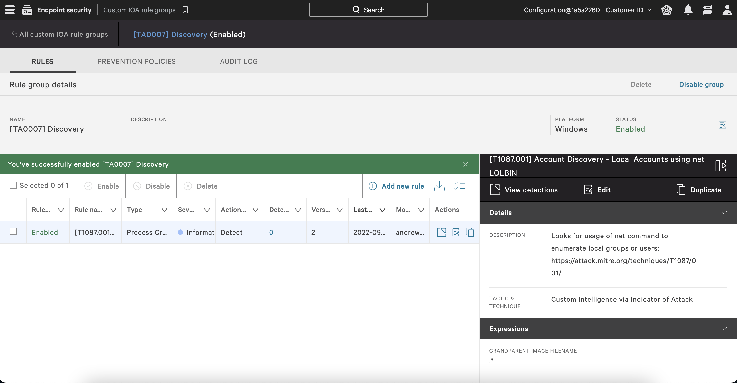

Slide 95
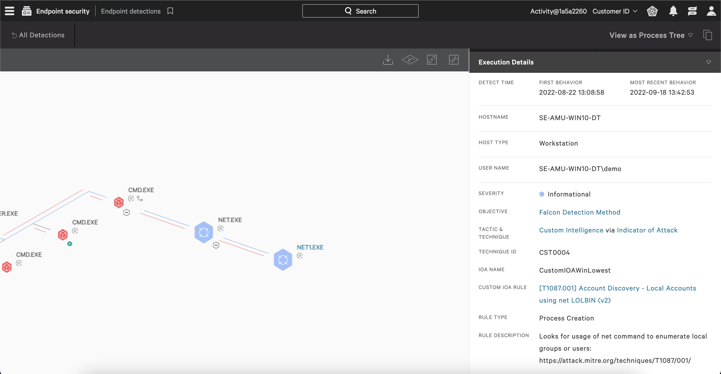

Slide 96
Twitter Tradecraft

Slide 97
1. Hypothesis

Slide 98
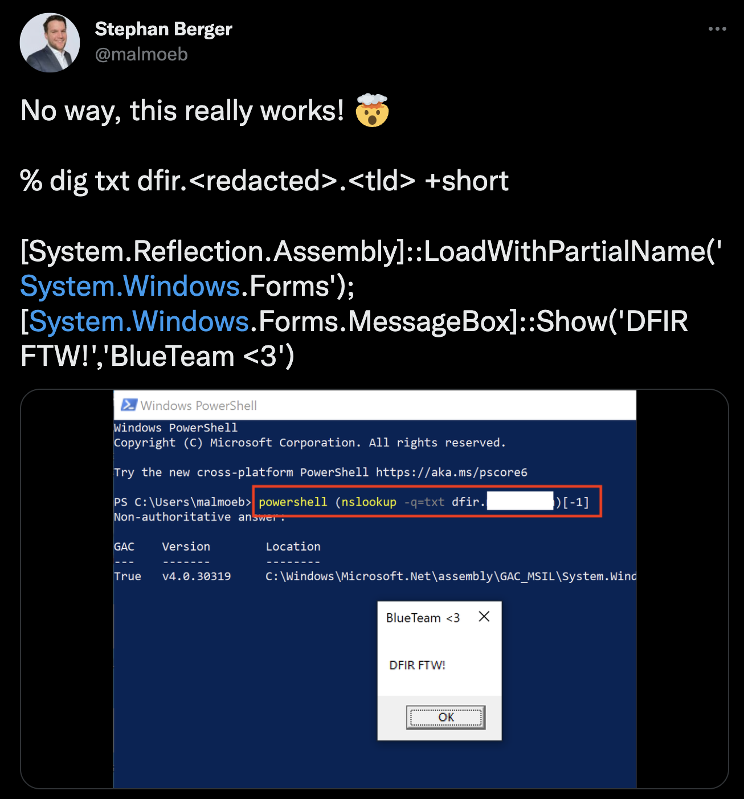
Hypothesis
When you’re looking at security articles, the hypothesis is sort of already made for you
“This is bad.”
What we need to do is analysis to see how common or uncommon it is in our environment.
Hypothesis: PowerShell invoking NSLookup to invoke or download a text file should be uncommon.

Slide 99
2. Create Logic

Slide 100
T1059.001 – Command and Scripting Interpreter: PowerShell
Event Search | LogScale
event_platform=win event_simpleName=ProcessRollup2 ParentBaseFileName=powershell.exe FileName=nslookup.exe | stats dc(aid) as uniqueEndpointCount, count(aid) as executionCount, dc(CommandLine) as cmdLineVariations, values(CommandLine) as cmdLines by ParentBaseFileName, FileName | event_simpleName=ProcessRollup2 event_platform=Win ParentBaseFileName=/powershell\.exe/i ImageFileName=/\\nslookup\.exe/i | ImageFileName=/\\(?<fileName>nslookup\.exe)/i | groupby([ParentBaseFileName, fileName], function=stats([count(aid, distinct=true, as="uniqueEndpointCount"), count(aid, as="executionCount"), count(CommandLine, as="cmdVariations", distinct=true), collect(CommandLine)]), limit=max)

Slide 101
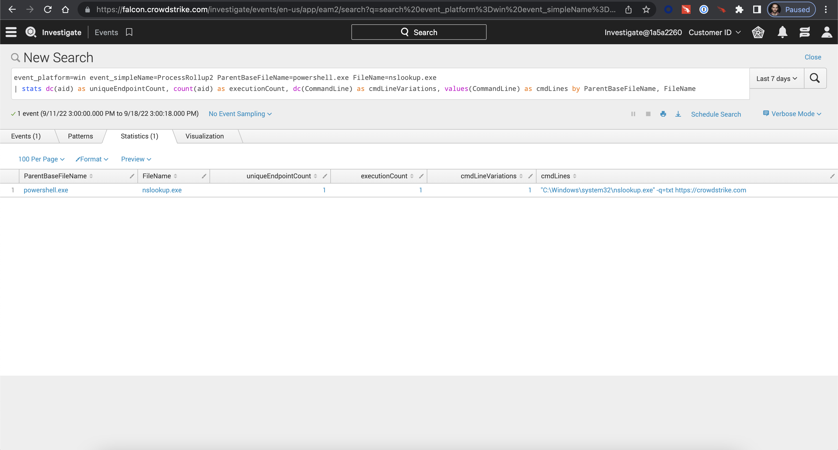

Slide 102
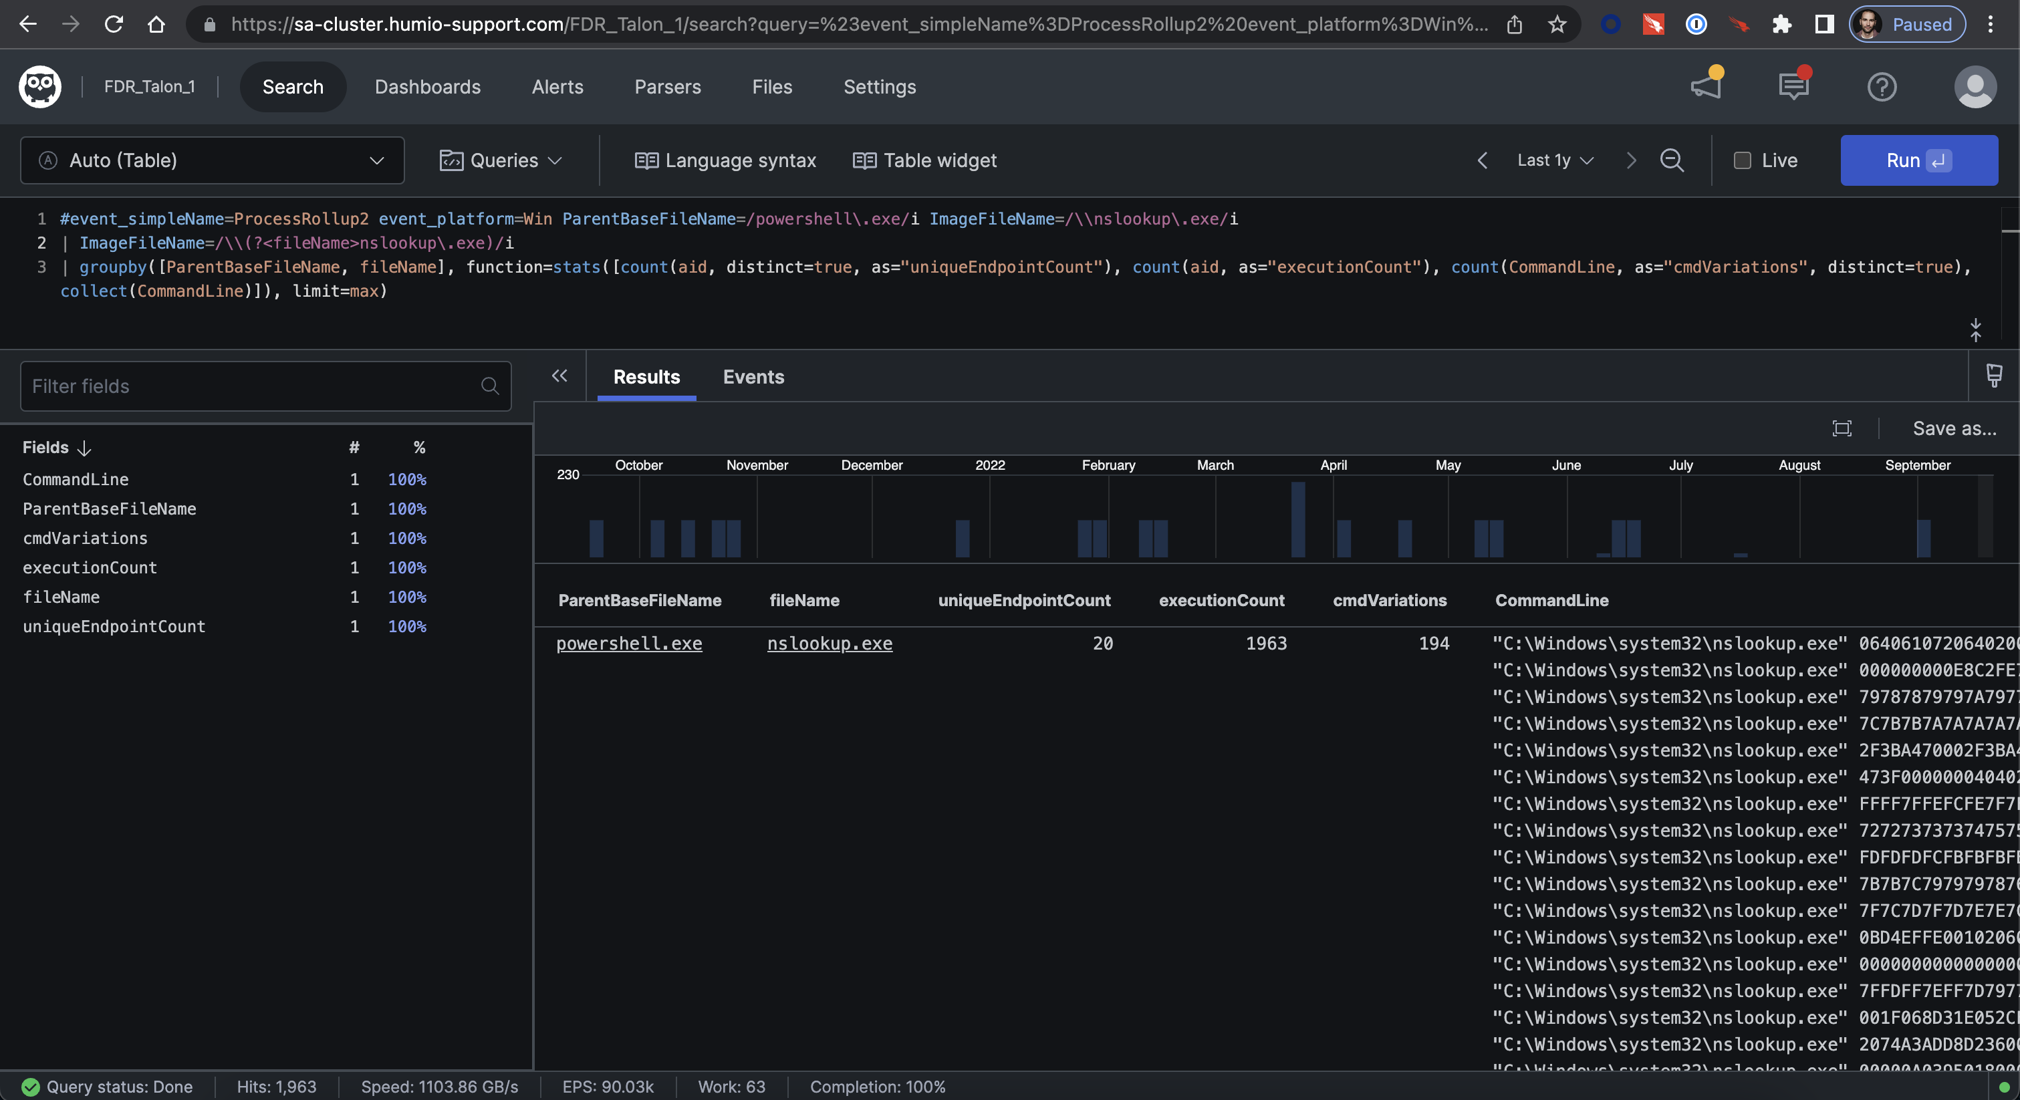

Slide 103
T1059.001 – Command and Scripting Interpreter: PowerShell
Event Search | LogScale
event_platform=win event_simpleName=ProcessRollup2 ParentBaseFileName=powershell.exe FileName=nslookup.exe | regex CommandLine=".*\s+\-q\=txt\s+.*" | stats dc(aid) as uniqueEndpointCount, count(aid) as executionCount, dc(CommandLine) as cmdLineVariations, values(CommandLine) as cmdLines by ParentBaseFileName, FileName | #event_simpleName=ProcessRollup2 event_platform=Win ParentBaseFileName=/powershell\.exe/i ImageFileName=/\\nslookup\.exe/i | CommandLine=/\s+\-q\=txt\s+/i | ImageFileName=/\\(?<fileName>nslookup\.exe)/i | groupby([ParentBaseFileName, fileName], function=stats([count(aid, distinct=true, as="uniqueEndpointCount"), count(aid, as="executionCount"), count(CommandLine, as="cmdVariations", distinct=true), collect(CommandLine)]), limit=max)

Slide 104
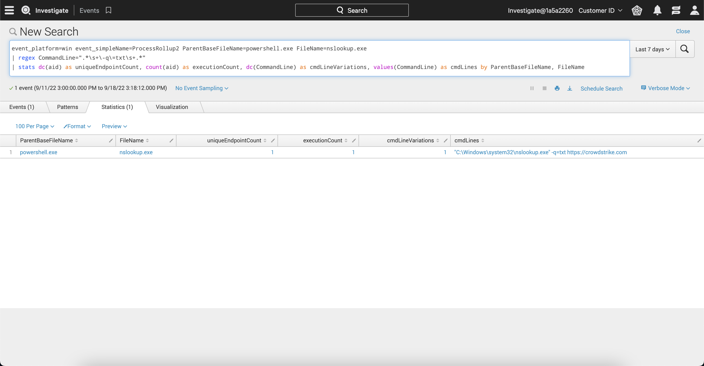

Slide 105
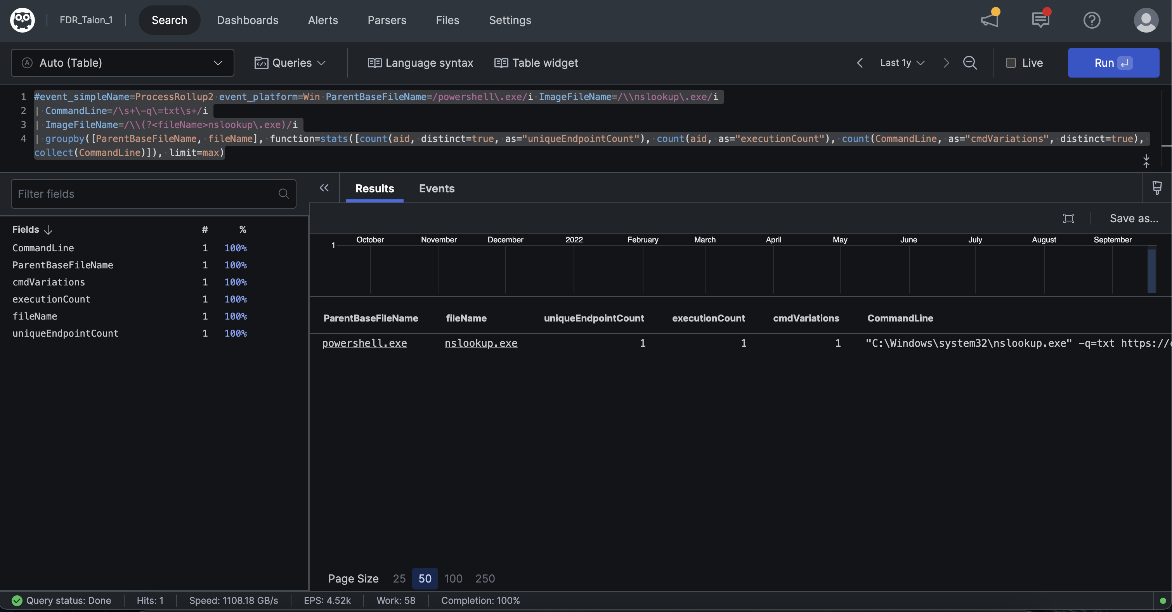

Slide 106
FYSA: Falcon has detection logic for this…

Slide 107
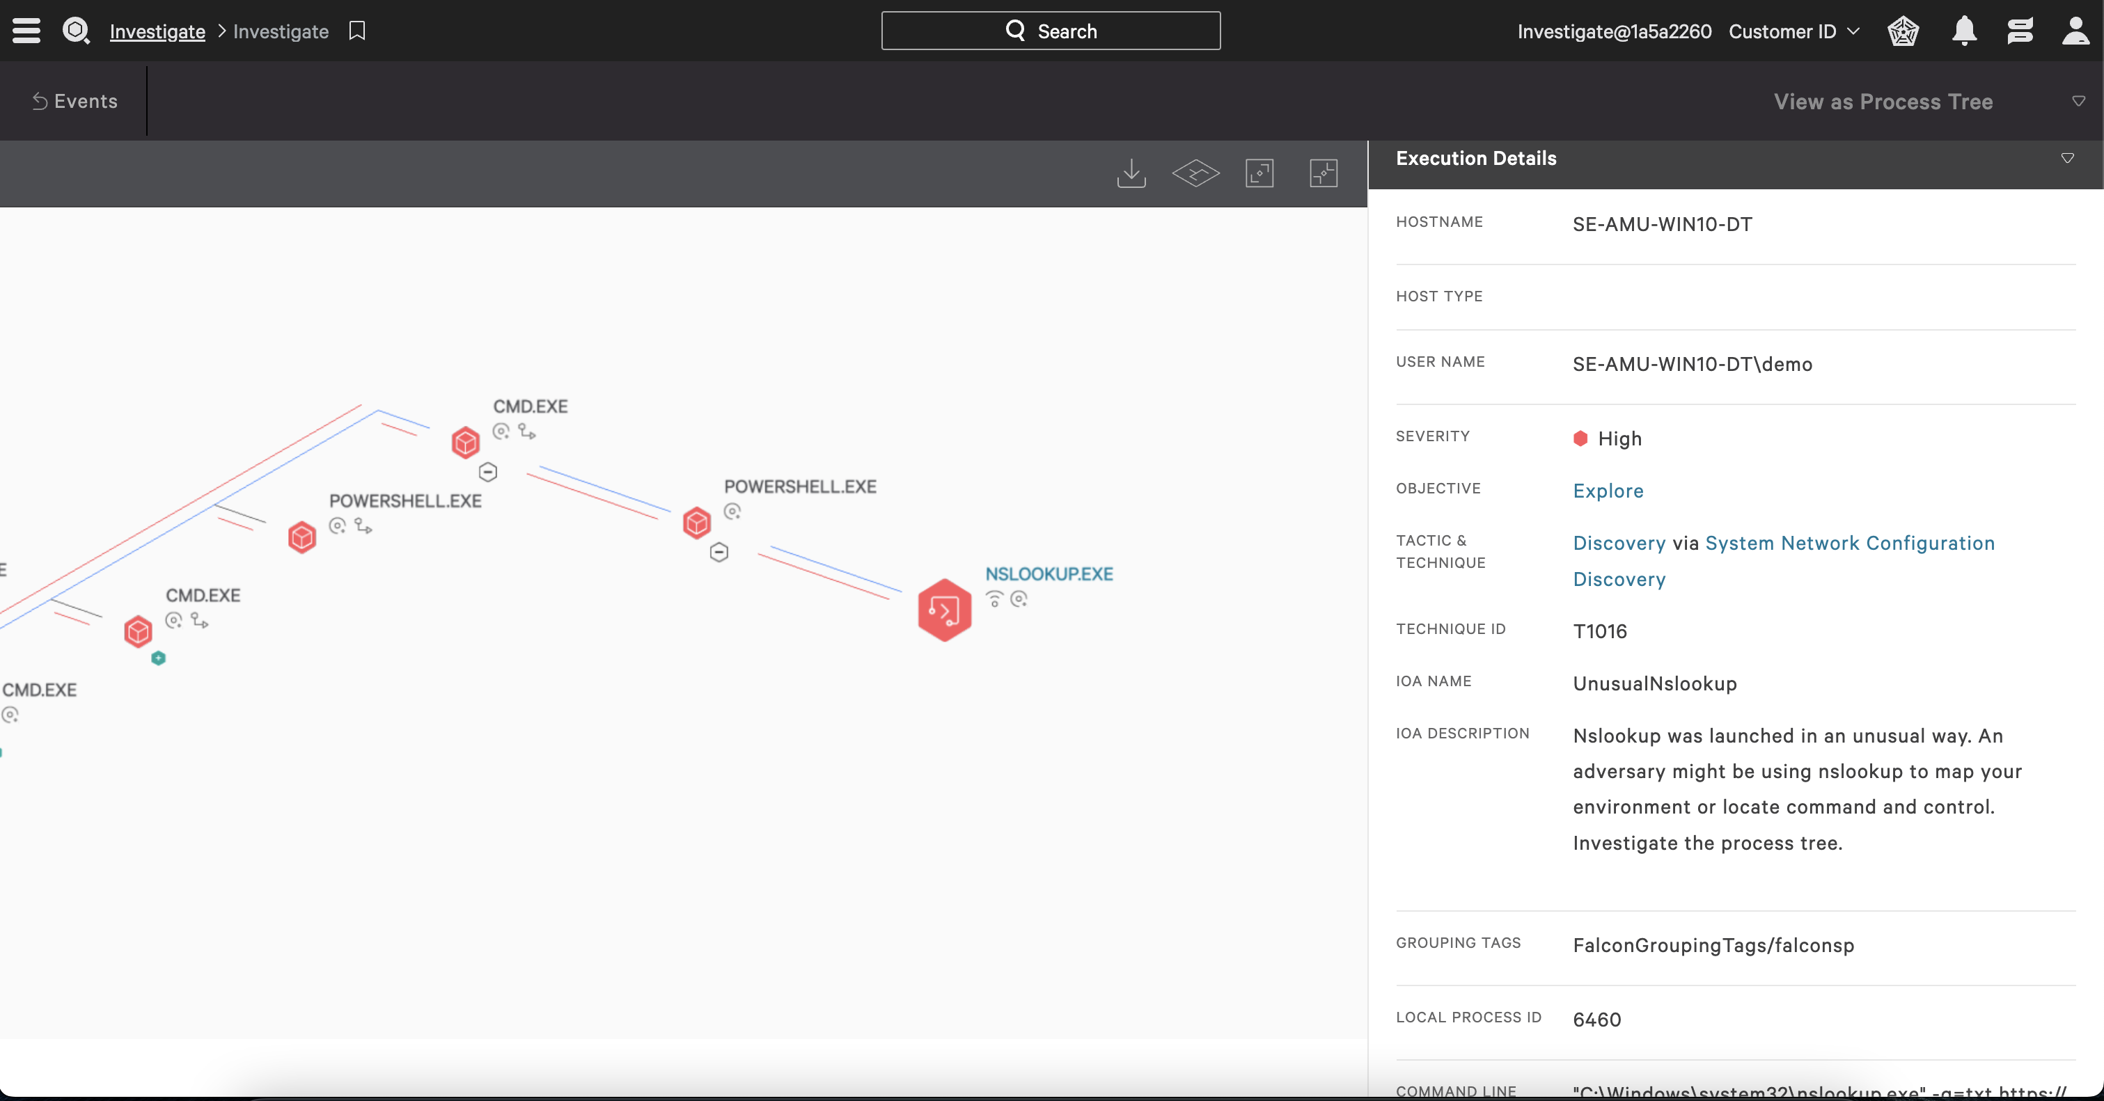

Slide 108
3. Document

Slide 109
Methodology
Hypothesis/Criteria
Create Logic
Document
Validate
Place in Harness
Test
Tune
Hypothesis created or criteria given
Create Evaluation Logic
Document iterations and steps
Test
Tune
Validate
Place in Harness

Slide 110
Experiment

Slide 111
Have fun

Slide 112
Thank you!

